Slide 1


Cybersecurity Risk Assessment and Mitigation Strategy:
Charity Project of Henrietta
“RiskArmor keeps your business strong, we guard your data all day long!”
Roberto Reade and Ben Sippel
September 24, 2025

Slide 2


Our Team
Roberto Reade
Ben Sippel

Slide 3
The Charity Project of Henrietta
Non-profit serving Western New York communities
Reliance on aging, inconsistent technology
Handles sensitive and HIPAA-relevant data
No formal IT or security governance

Slide 4
Engagement Goals
Quantify business impact
Assess IT and security maturity
Identify and prioritize risks
Produce a realistic 3-year improvement roadmap
Evaluate current technology and security practices against established maturity models
Establishes baseline understanding of how reliable CPH’s IT operations currently are
Identify threat/vulnerability pairs across systems, people and processes
Rank risks using structured methods to determine mission-threatening exposures
Translate technical risks into operational, financial, and regulatory consequences
Estimate downtime, data loss, compliance exposure, and recovery requirements
Develop a phased plan that sequences risk reduction based on severity, dependency, and organizational capacity
Prioritize foundational controls first, followed by structural improvements and governance

Slide 5
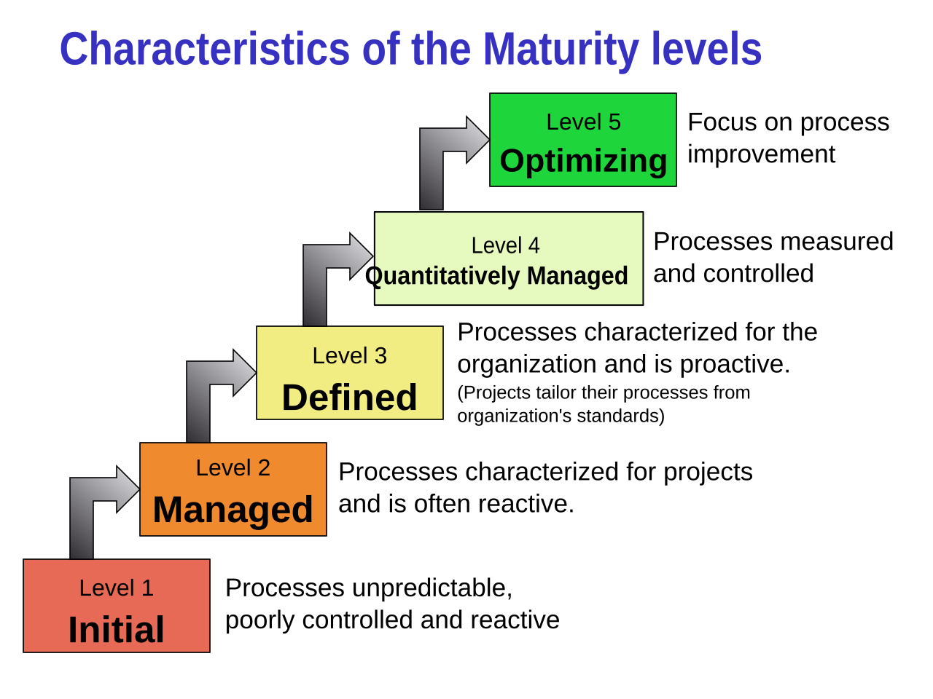
Current Security Posture
Reactive, undocumented controls
Security measures lack written standards, making them unreliable and difficult to sustain
Manual workarounds instead of processes
Day-to-day operations depend on improvised fixes rather than defined procedures, increasing operational fragility
Ad-hoc Maturity Level
No baseline security hygiene
Security activities are performed inconsistently and lack formal, repeatable procedures
Fundamental protections such as consistent patching, encryption, and standardized configuration are missing across systems

Slide 6

Good Practices Observed
Use of Paychex and related financial processes
Access to Paychex restricted to finance and accounting staff
A defined password policy is in place
Servers, desktops, and laptops have McAfee deployed
Accurate device inventory maintained
Notes:
Use of Paychex and related financial processes
Reducing internal handling of sensitive data
Reducing reliance on insecure workflows
Access to Paychex restricted to finance and accounting staff
Limiting exposure of payroll and financial information
Reducing unnecessary privilege distribution.
A defined password policy is in place
Employees are trained every 3 months on how to comply
Servers, desktops, and laptops have McAfee deployed
Establishing a baseline level of endpoint protection
Accurate device inventory maintained
Giving clear asset visibility

Slide 7

High Level Concerns
Outdated Software
No Encryption
Lack of Training & Improper Handling of Information
Unpatched Windows OS and Microsoft Office software is unreliable, error-prone, and creates operational instability and vulnerability exposure.
No encryption on systems or stored data, leaving all information accessible in cleartext.
Lack of cybersecurity training and improper handling of HIPAA-relevant information, resulting in elevated human-factor risk and potential regulatory violations.

Slide 8
Risk Ranking and Findings
Identify Threat/Vulnerability pairs
Determine likelihood and impact of each pair
Determine relative position and severity
Goal: Assess using our Risk Assessment Framework
Using our Risk Profile Table
Using our 3x3 Risk Matrix
This process allowed for consistent risk ranking, assigning each finding a risk level from Low to Critical based on the combination of how likely the event is to occur and the potential operational, financial, or regulatory impact.

Slide 9
 | Likelihood | Impact
Small Risk | Very unlikely this risk will happen (once every 2 years) | Minimal disruption; negligible operational or financial effect
Moderate Risk | This risk may happen sometimes (once every 6-12 months) | Noticeable disruption; limited operational or financial strain
Large Risk | This risk is likely to happen in near future (once every 2-3 months) | Significant disruption; major operational or financial damage
Critical Risk | This risk will definitely occur in very near future (once every 2 weeks) | Severe disruption; mission-threatening operational or financial loss
Impact → Likelihood↓ | Low Impact | Moderate Impact | Large Impact
Low Likelihood | Low | Moderate | Large
Moderate Likelihood | Moderate | Large | Critical
High Likelihood | Large | Critical | Critical
Figure 1: Risk Profile Table
Figure 2: 3x3 Risk Matrix
Risk Assessment Framework

Slide 10
Risk #1: Malware Execution
Attackers use documented vulnerabilities in outdated Windows and Office products to achieve dependable code execution.
Unpatched flaws provide a predictable path for payload delivery, escalation, and system control.
With a moderate likelihood of happening, this poses a large impact risk since it threatens significant disruption if services are taken down.
Recommendation: NIST controls CM-7 (Least Functionality), SI-3 (Malicious Code Protection), and CM-6 (Configuration Settings)
Risk Rating: Critical

Slide 11
Risk #2: Unprotected Data Exposure
Cleartext storage allows anyone with system access to read or copy data without encountering any security barriers.
This removes the need for technical exploitation and turns any access event into a full data exposure.
The result is immediate loss of confidentiality across all stored information, which poses a large risk due to potential financial and reputational damage.
Recommendation: NIST controls SC-13 (Cryptographic Protection), AC-2 (Account Management), and IA-2 (Identification and Authentication)
Risk Rating: Critical

Slide 12
Risk #3: Human-Factor Security Gaps
Cleartext storage allows anyone with system access to read or copy data without encountering any security barriers.
This removes the need for technical exploitation and turns any access event into a full data exposure.
The result is immediate loss of confidentiality across all stored information, which poses a large risk due to potential financial and reputational damage.
Recommendation: NIST controls AT-2 (Security Awareness Training), AT-3 (Role-Based Training), and PS-6 (Personnel Security - Position Risk Designation)
Risk Rating: Critical

Slide 13
Cost Benefit Analysis: Malware Execution
Goal: Evaluate annual expected loss for the top risk and help determine whether the investment effectively reduces financial exposure
Asset Value: $3,000,000
Exposure Factor: 50%
Single Loss Expectancy: $1,500,000
Annual Rate of Occurrence: Once every five years (⅕)
Annual Loss Expectancy: $300,000
Risk Mitigation: EDR solution
Control annual cost: $12,600
  +$1,000 one-time training cost
  +$600 annual maintenance
Annualized over 3-year tool life: $5,133.33

Slide 14
$294,866.67
Annual Loss Reduction
Takeaway: Implementing the control would be highly cost-effective for CPH

Slide 15
3-Year Outlook
High-level overview

Slide 16
Year 1
Replace outdated Windows and Office Systems
Implement Full Disk & Data Encryption
IT Manager
IT Manager
Centralize File Storage
Deploy Basic Security Controls
IT Manager
IT Manager

Slide 17
Year 2
Network Segmentation
MFA Implementation
IT Manager
IT Manager
Centralized Backup & Recovery
Log Collection & Security Monitoring
IT Manager
IT Manager

Slide 18
Year 3
Formal IT & Security Policies
Annual Risk & Security Review
IT Manager / Leadership
IT Manager
Staff Security Awareness Training
Disaster Recovery Plan Enhancements
Human Resources, IT
IT Manager / Leadership

Slide 19
Other Findings
Risk Register with DREAD
Fishbone
Provides CPH with a clear view of priorities and actionable recommendations, with top risks mapped to NIST controls for guidance
Scored Vulnerability/Threat pairs using the DREAD model, which prioritizes which risks are most serious
Conducted root cause analysis, identifying factors in CHP’s top risk: Malware Execution on outdated Windows and Office systems
Clarifies each underlying cause driving malware execution risk
Business Impact Analysis (BIA)
Performed BIA for the three identified critical risks, which evaluated operational, financial, and regulatory risk impacts for each
Estimates potential downtime, data loss, and compliance consequences

Slide 20
Thank you
For Questions Contact:
Roberto Reade
Ben Sippel

